Slide 1

ONLINE LAW SYSTEM
Bringing Justice

Slide 2
Introduction
The project simplifies the life of common citizen, by providing various services, helping people to get justice without much delay and giving them updated information about various laws in our country.
The web application has a user friendly interface and provides updates to users about their activities, like, user registration, hiring a lawyer, updating the user if his/her case is accepted or rejected by the lawyer and much more.
Front end is based on HTML, JSP, CSS, JavaScript, Bootstrap framework, AJAX and for backend we are using Servlets, JAVA classes.
We are using Oracle 11g for database and the application is developed using Netbeans IDE and GlassFish Server 4.1.1.

Slide 3
Modules
Admin
Add Lawyer
Delete Lawyer
Add Court
Add Law
Manage FIR(s)
User
Hire Lawyers
FIR
Search Laws
Search Courts
Filed FIR(s)
Lawyers
Search requested cases, update status of cases.

Slide 4
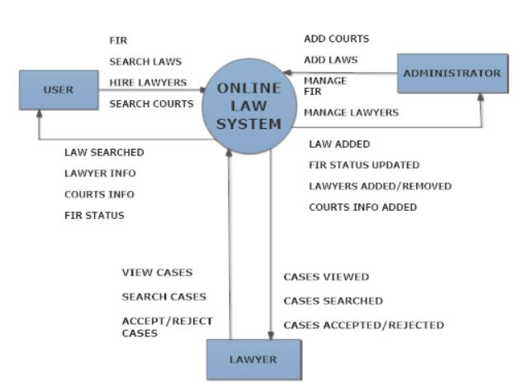
0 Level Data Flow Diagram

Slide 5
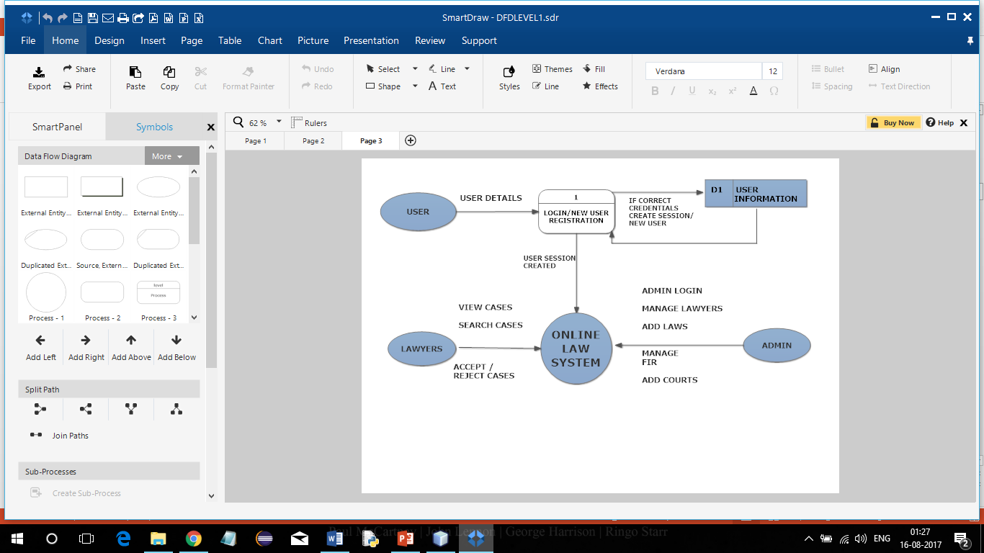
1 Level Data Flow Diagram

Slide 6
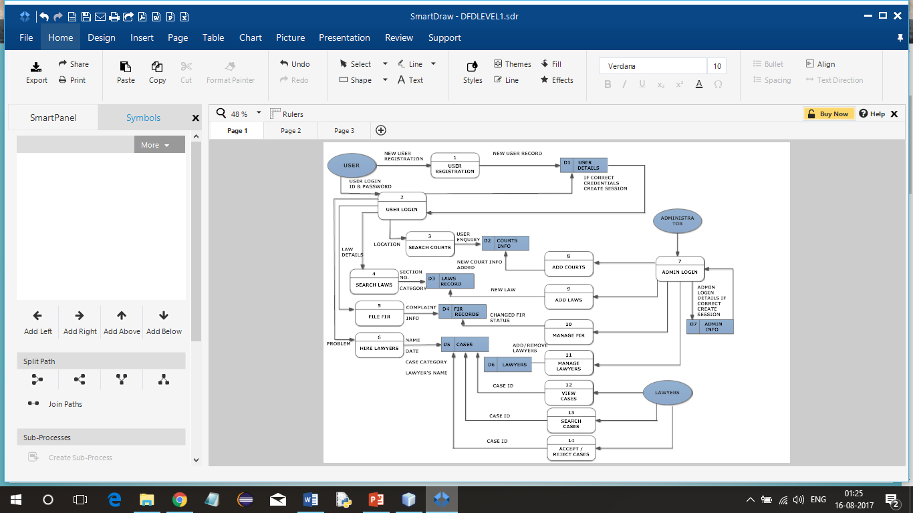
2 Level Data Flow Diagram

Slide 7
PROJECT SCREENSHOTS

Slide 8
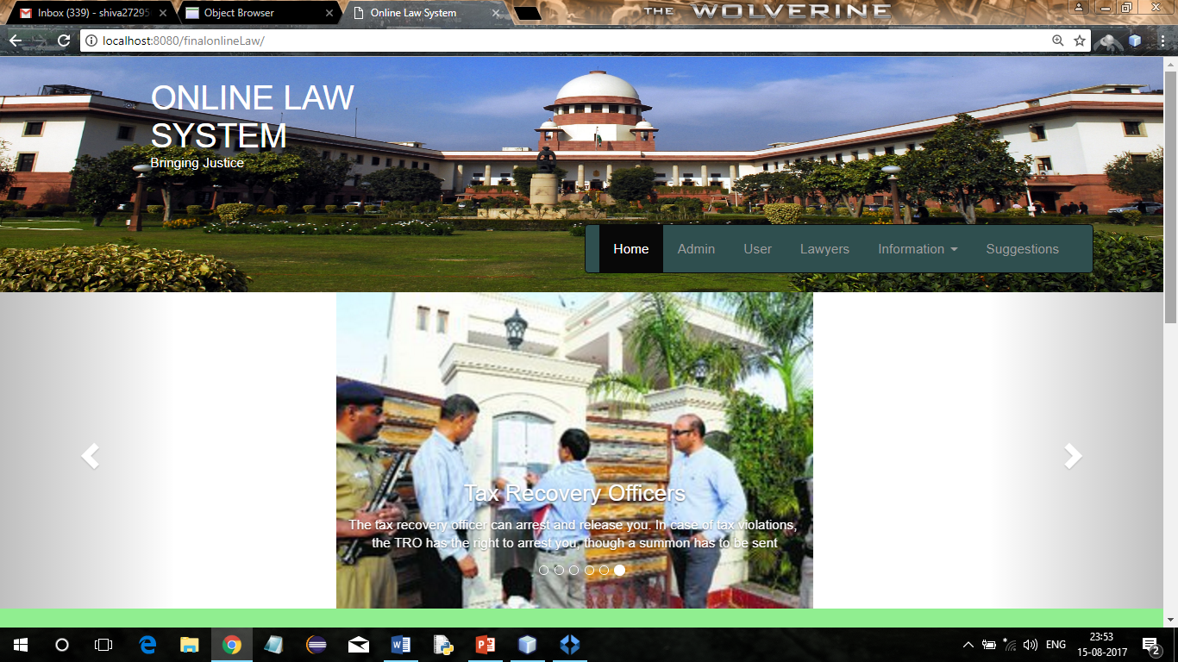
Home page-1

Slide 9
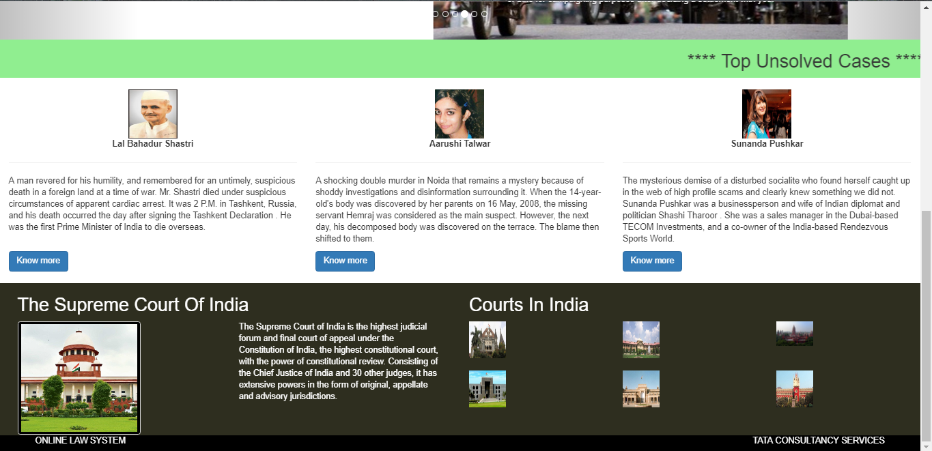
HOME PAGE-2

Slide 10
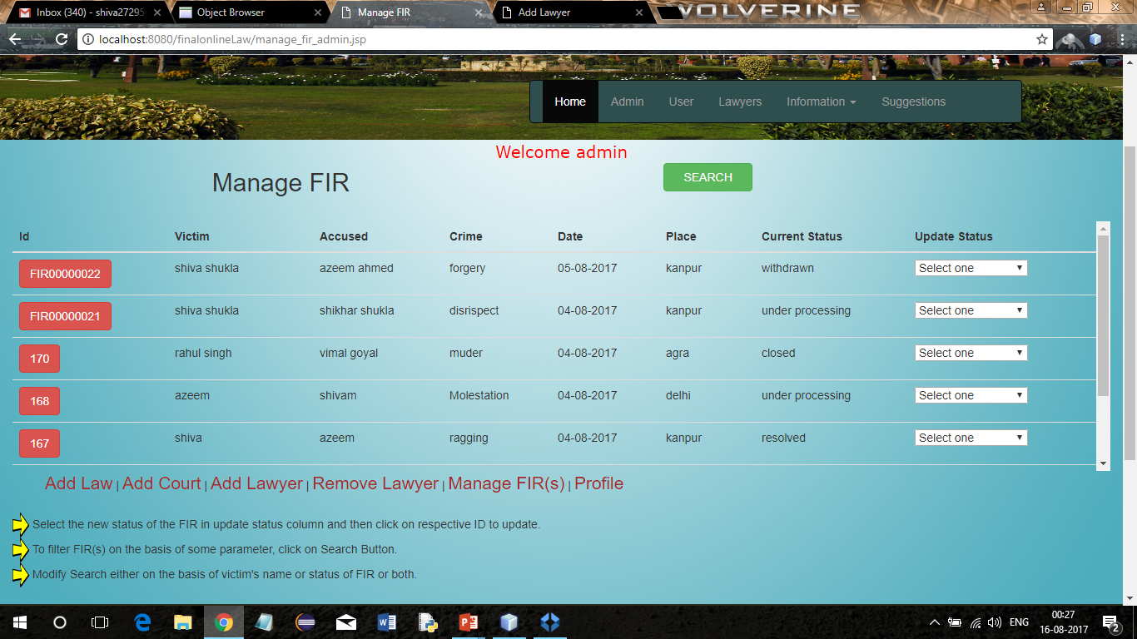
Manage fir

Slide 11
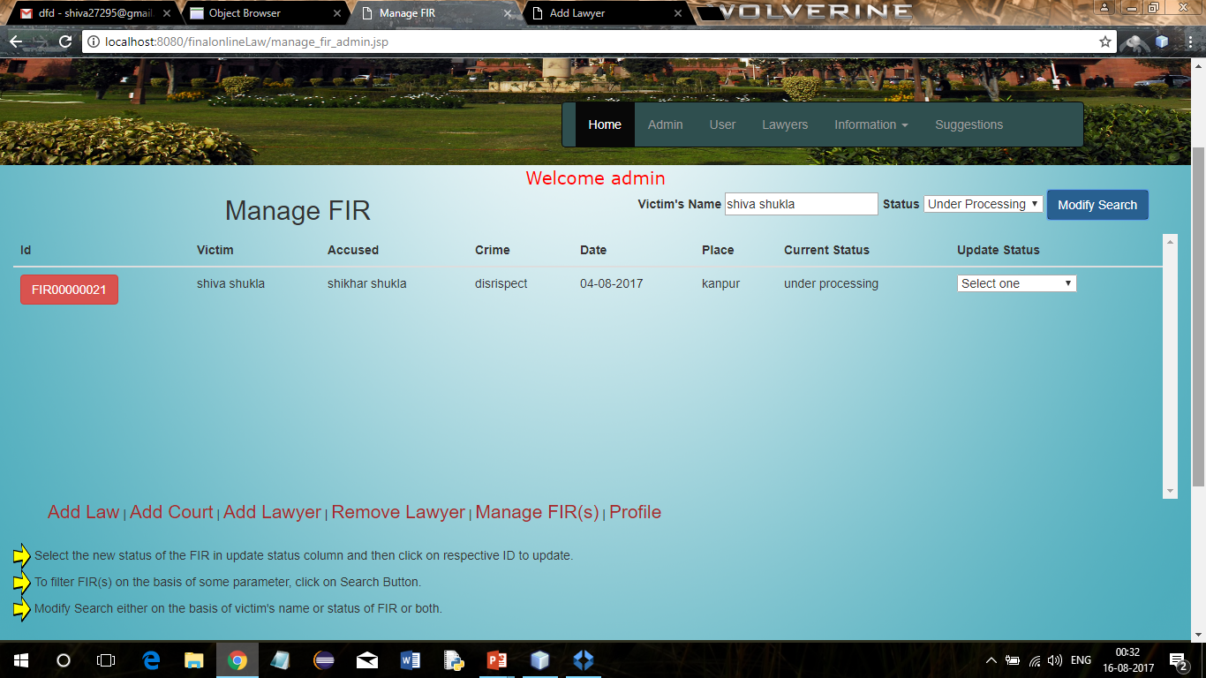
Manage fir (search)

Slide 12
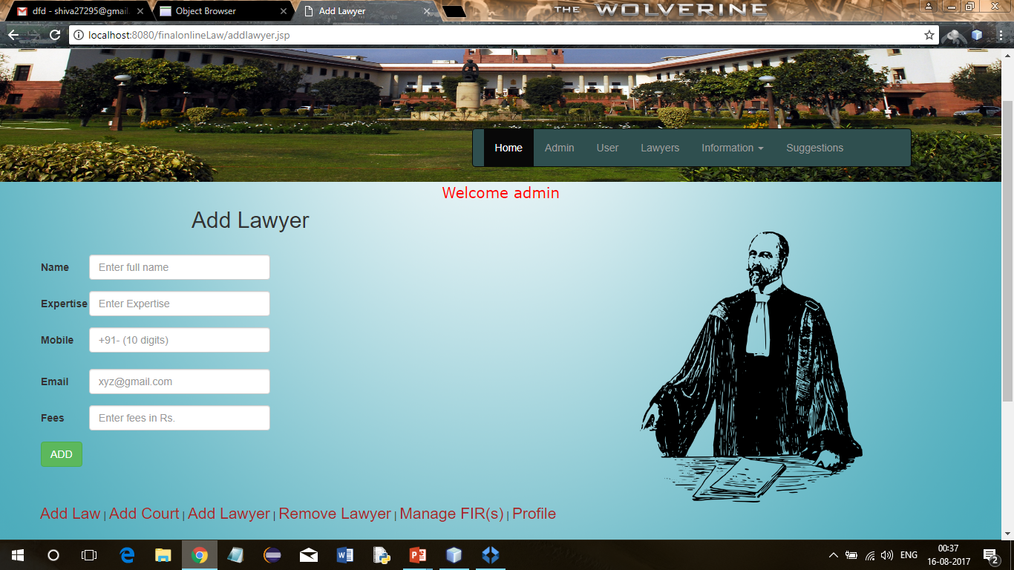
Add lawyer

Slide 13
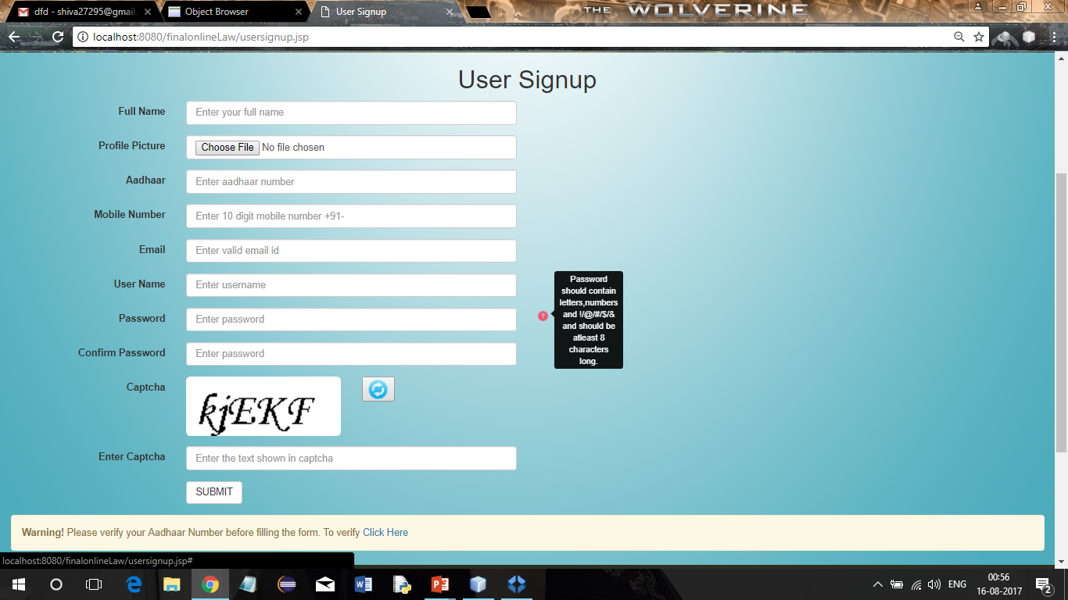
User signup

Slide 14
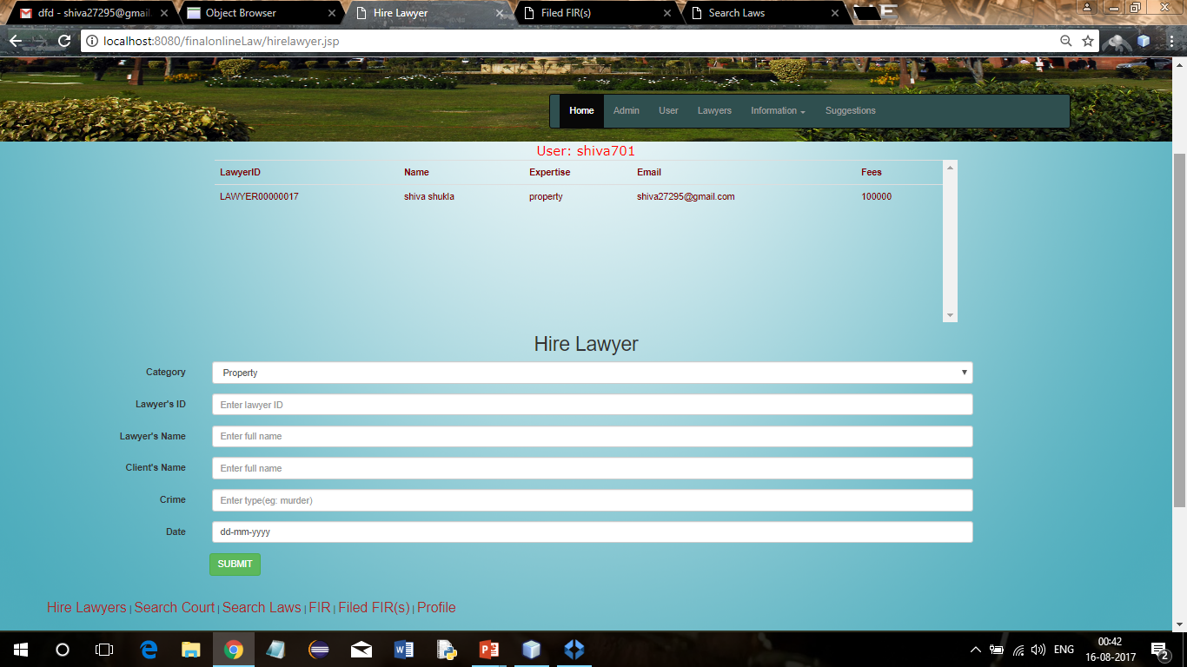
Hire lawyer

Slide 15
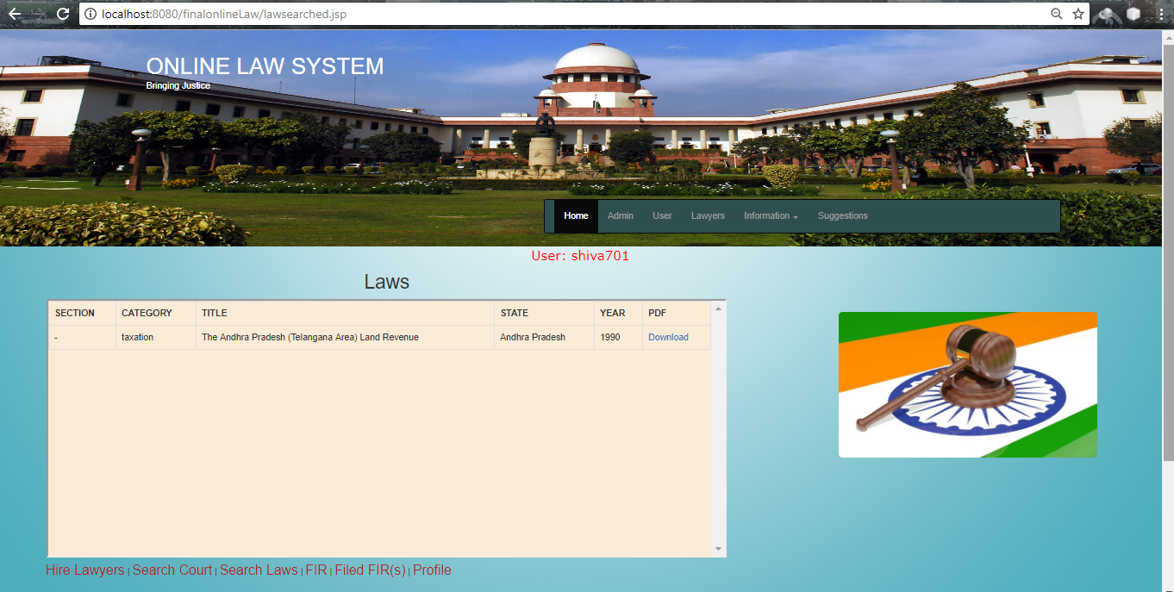
Searched Laws

Slide 16
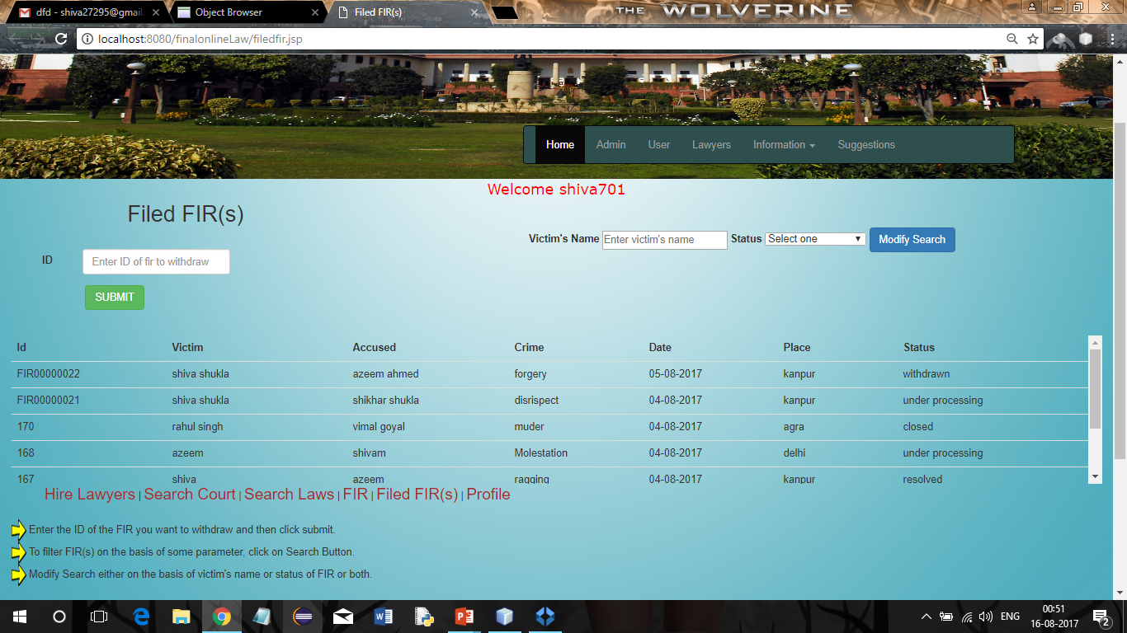
Filed fir(s)

Slide 17
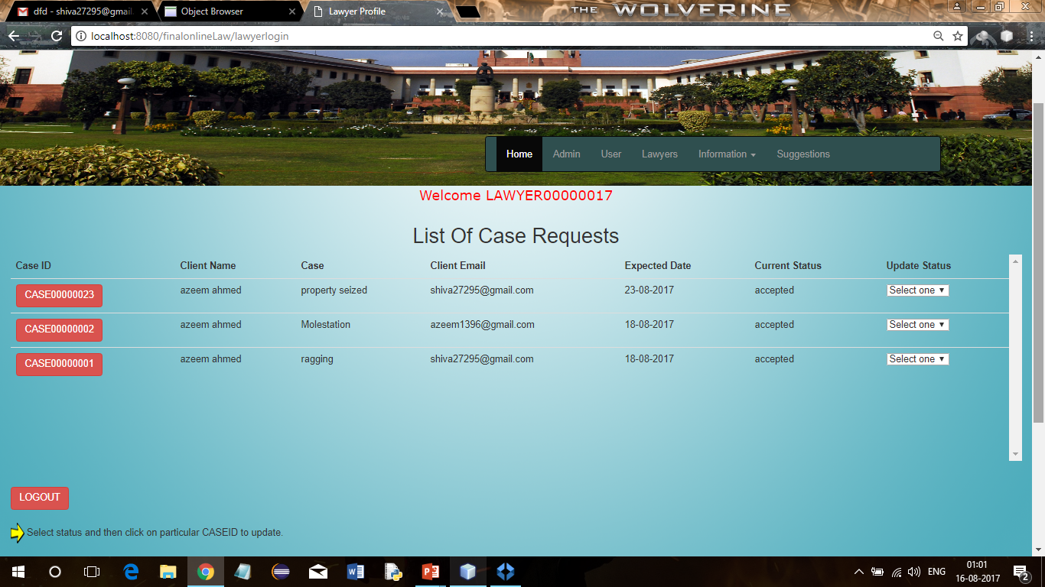
Lawyer profile

Slide 18
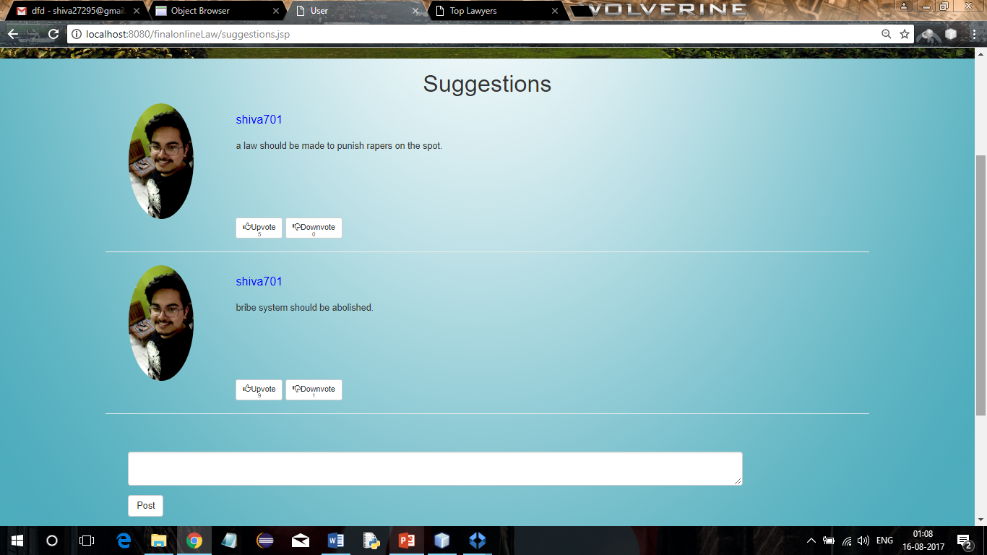
Suggestions page

Slide 19
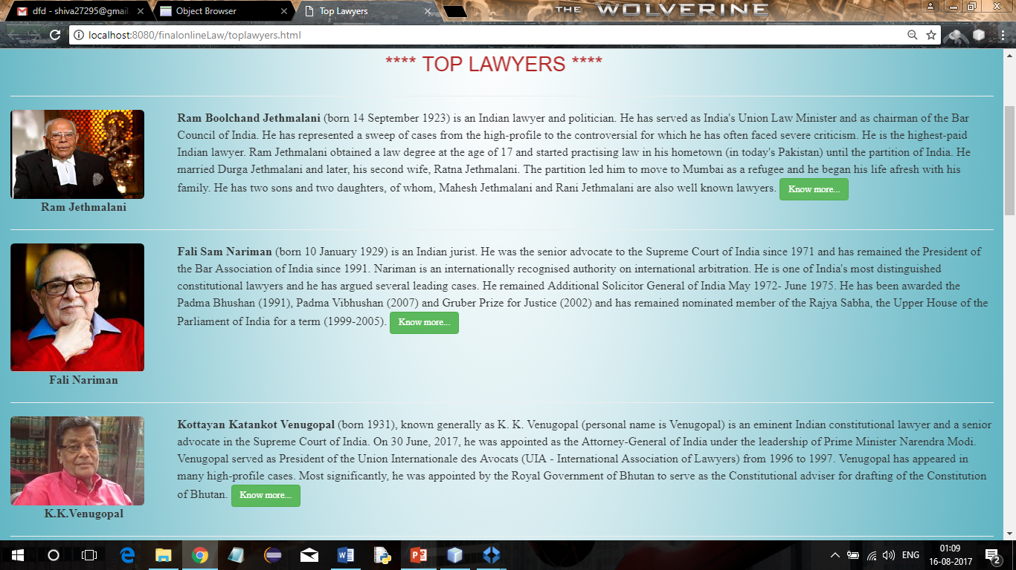
Top lawyers
*There are two more pages for top criminals and renowned cases in India.

